Slide 1



Capstone Project Phase A
24-1-D-40
Nitsan Maman
Ron Shahar
Advisor: PhD. Sulamy Moshe

Slide 2
Chapter 1 -
Introduction

Slide 3
Background
Decline in traditional storytelling engagement
Static, predictable stories lose appeal
Current attempts to address this issue focus on text-based engagement

Slide 4
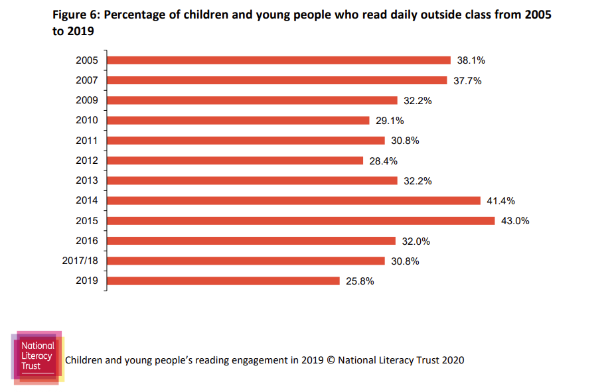
Background
Christina C, “Children and young people’s reading in 2019” National Literacy Trust research report

Slide 5
Chapter 2 -
Related Work

Slide 6
Alternative Solutions
“AI-powered chatbots” maintaining interest in reading.
“AI Dungeon” offers infinite choice based stories.
“Digital storytelling platforms” create immersive and engaging stories.

Slide 7

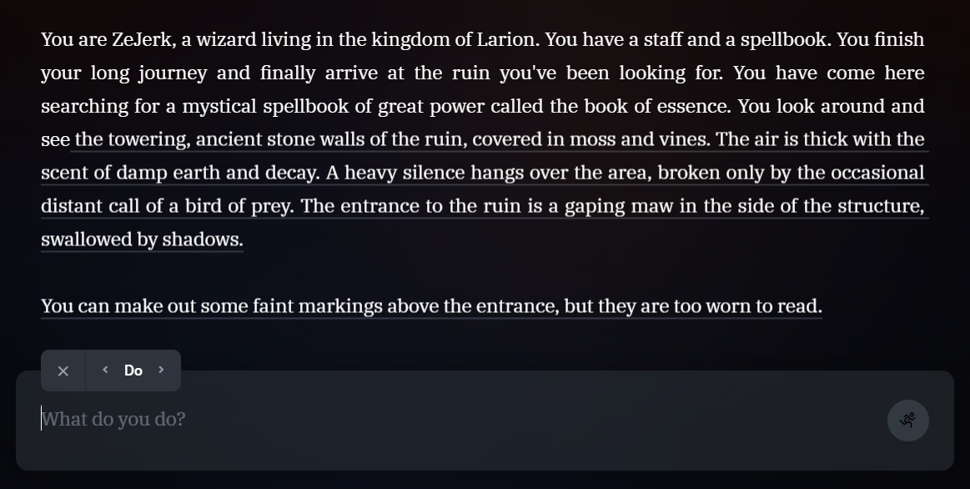
Alternative Solutions

Slide 8
Chapter 3 -
Expected Achievements

Slide 9

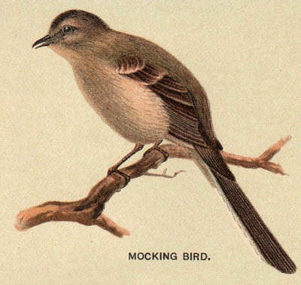
Our Game - TaleWeaver
TaleWeaver is a game developed in Unity with the goal of integrating AI to create personalized, dynamic storytelling experiences.
CHANGE THIS TEXT TO FIX IMAGE
TaleWeaver - Book Scene in Unity

Slide 10


Story Integrated By AI
AI crafts dynamic narratives.
Each page will include an AI-generated image.
AI-generated picture by our model in DALL-E
Notes:
"blankets," on top of the logic for each user input using the OpenAI ChatGPT model , Player inputs will guide the story changes.
to represent the ongoing narrative using DALL-E. Visuals, themes will align with player actions

Slide 11
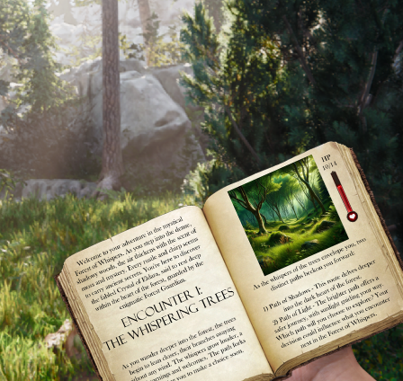
Adaptive Game Environments
Keyword extraction algorithm RAKE detect matched environment in the given text.
Players can pause reading and immerse themselves in their surroundings.
An adventure set in the forest
Notes:
the atmosphere and theme of the story within the book enabled by keyword extraction algorithms that detect locations based on the given text Why Rake algorithm? – 1) well suited for real time application because it is fast, efficient and low-cost performance 2) it is simple to implement and doesn’t require extensive training data 3) effective with short text how it RAKE works? - 1) Unsupervised 2) remove common words 3) rank

Slide 12
Game Logic Designed by Developers
To ensure balanced gameplay, developers will handle the game logic, ensuring alignment with the pre-created AI story and theme.
This ensures consistent and engaging gameplay.

Slide 13
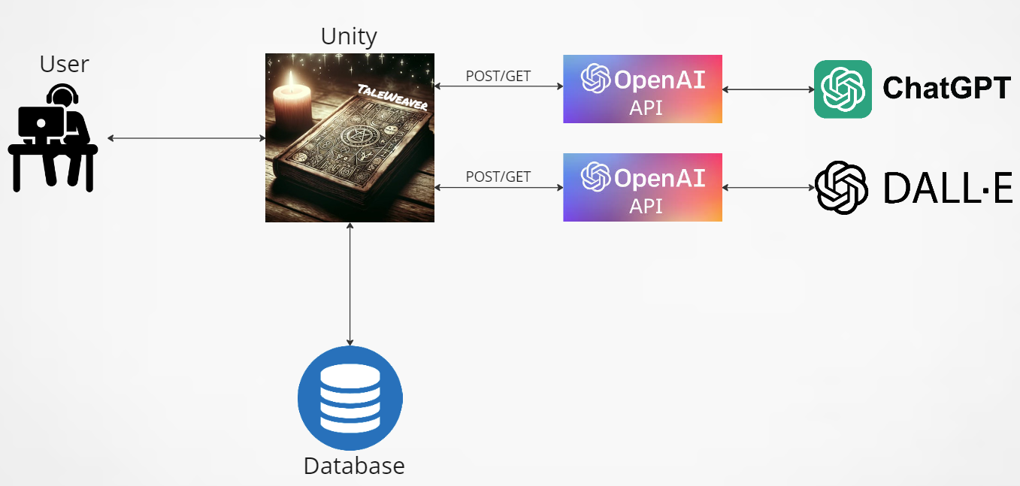
Architecture overview

Slide 14
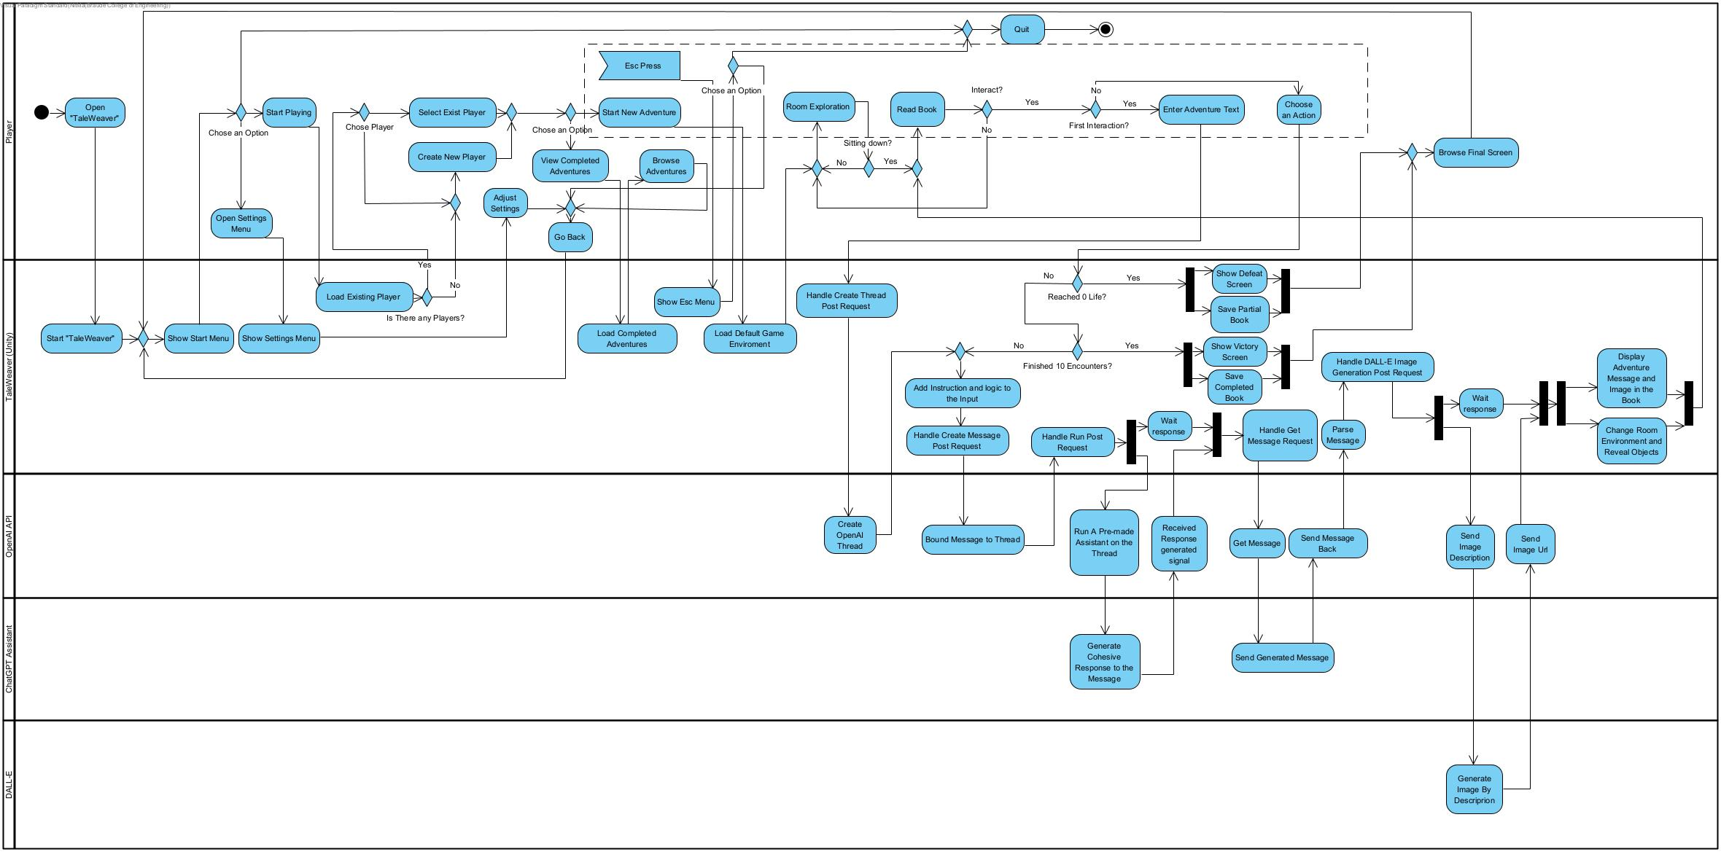
14

Slide 15
Screens and Flow

Slide 16
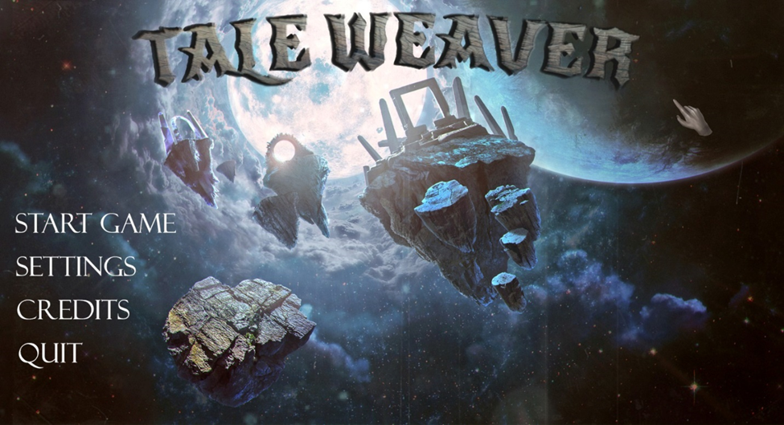
Main Menu

Slide 17
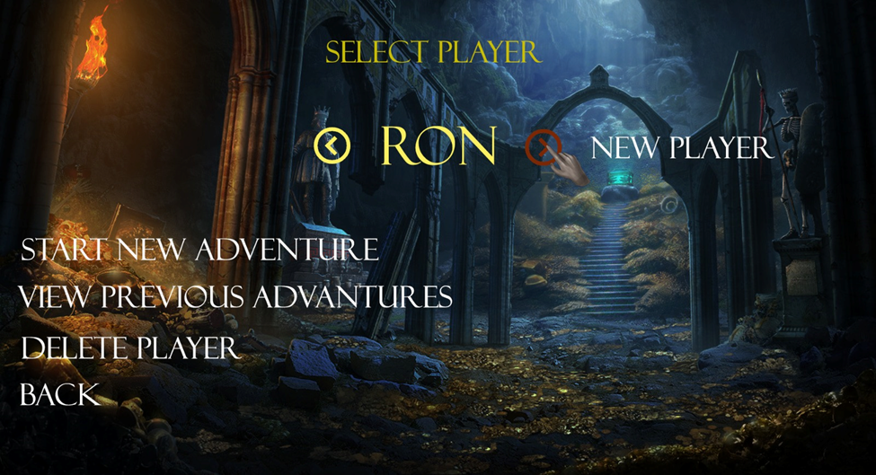
Start Game
and player
selection

Slide 18
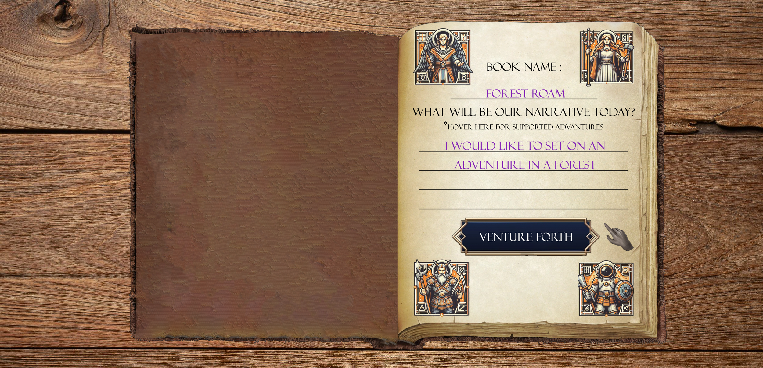
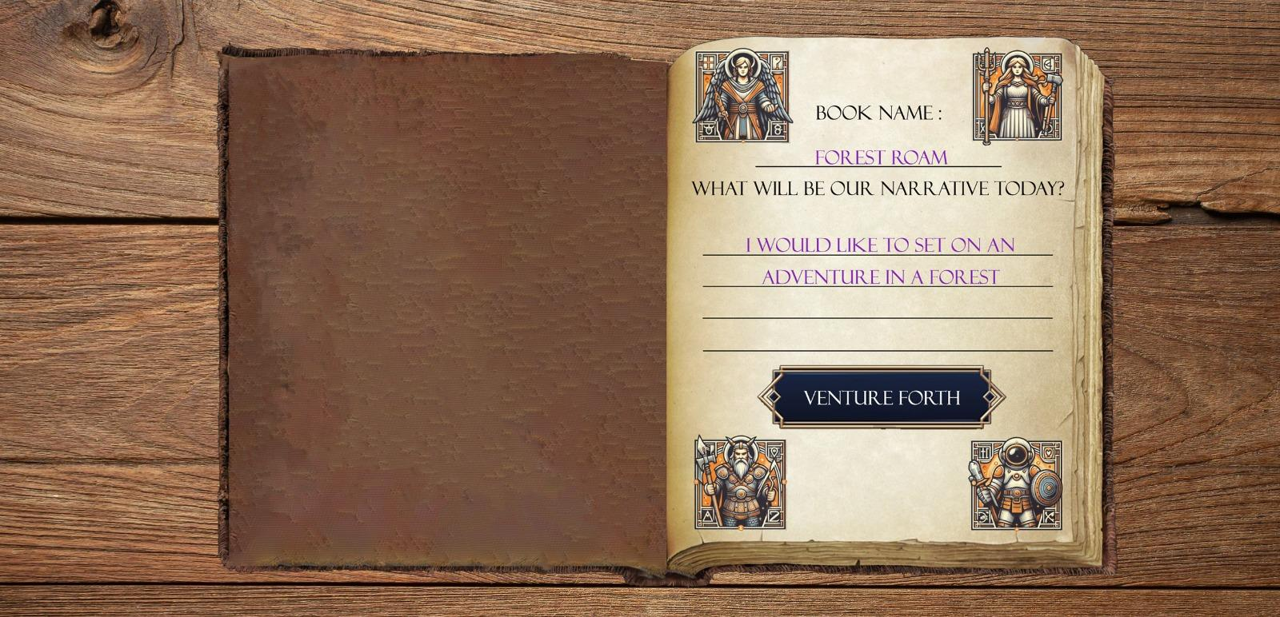
Start New Adventure
Notes:
Hover will open tooltip box with: Currently supports: desert, space, forest, ……. Selecting an area that is not included in the list will bring you to a generic environment which will detract from the game experience
Hover Here for Supported Adventures: Positioning your cursor over this option will display a tooltip that reads: "Currently Supported Environments: Desert, Space, Forest, etc. Selecting an environment not listed may lead you to a generic setting, potentially diminishing the immersive quality of your experience." This feature informs players of the available environment options and their impact on gameplay immersion.

Slide 19
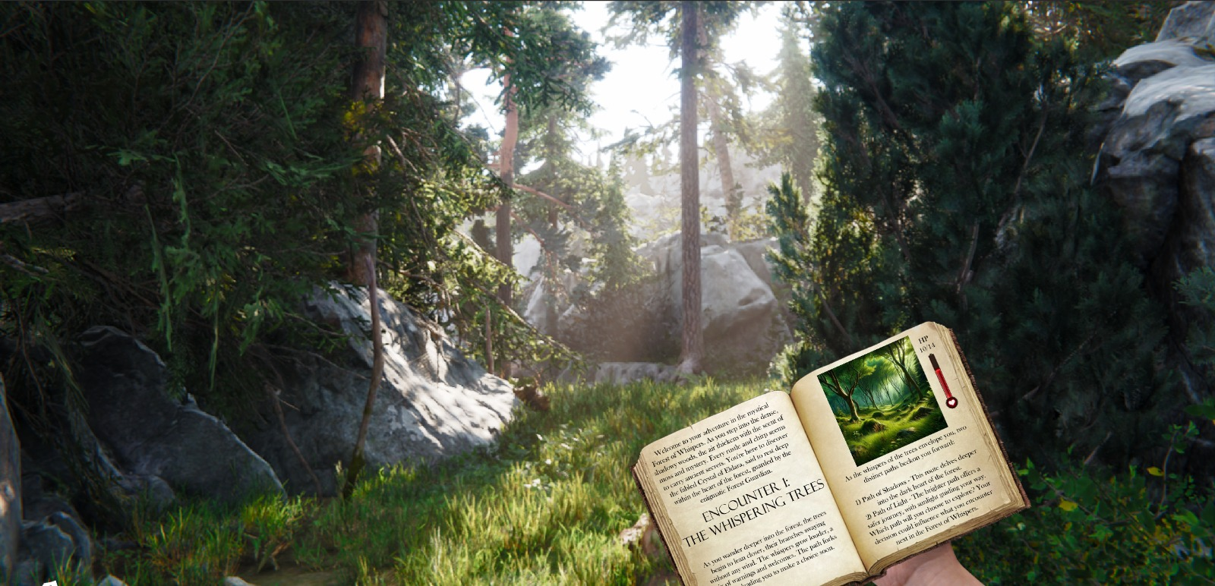
Environment Exploration

Slide 20
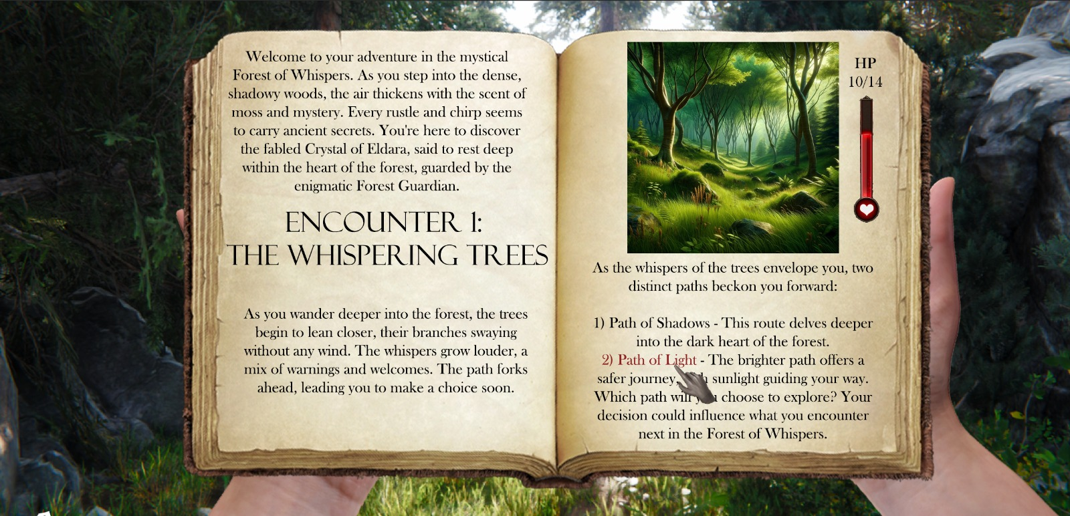
Book Interaction

Slide 21
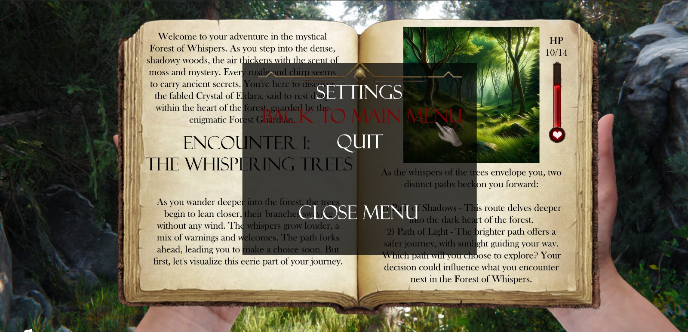
Pause Menu

Slide 22
Chapter 4 -
Challenges

Slide 23
Possible Challenges
Unity's complexity demands deep knowledge
OpenAI API integration tests technical limits
Managing costs, API calls crucial for efficiency
Balancing AI storytelling with interaction
Keyword extraction integration posed challenges

Slide 24
Chapter 5 -
Verification plan

Slide 25
Testing Plan - Key Points
test | module | Tested Function | Expected Result
1 | Gameplay | Input Processing | Accurate reflection of input in narrative
2 | AI Integration | ChatGPT API assistant Integration | Relevant text generation for given prompts
3 | AI Integration | Keyword Extraction | Correct keywords extracted from input

Slide 26
Testing Plan - Key Points
test | module | Tested Function | Expected Result
4 | AI Integration | DALL·E Integration | Accurate and timely image generation
5 | Game Environment | Room Update | Room adjusts based on keywords
6 | User Interface | Navigation | Intuitive and responsive UI navigation

Slide 27
Criteria for Evaluation
Dynamic narrative and visual generation
Adaptation to user input context
Immersive and unique storytelling experience
Coherence and relevance of stories
Accuracy and effectiveness of keyword extraction
Consistency in altering game environment
User engagement and satisfaction levels
Feedback and insights from playtesting

Slide 28

THANKS!
Any questions?

